Slide 1
6.4 Partial Differential Equation
指導老師：戴天時教授
學 生：王薇婷

Slide 2
The Feynman-Kac Theorem
Previous section:
Convergences slowly
the Euler method
Gives the function value for only one pair ( t, x)
Convergences quickly
Numerical algorithm
Gives the function for all value of ( t, x)

Slide 3
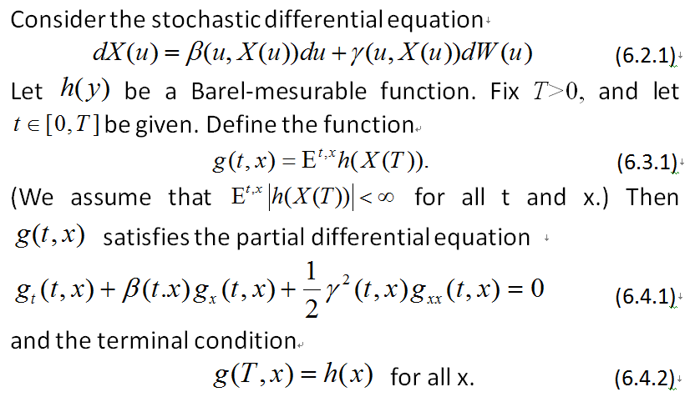

Theorem 6.4.1 (Feynman-Kac)

Slide 4
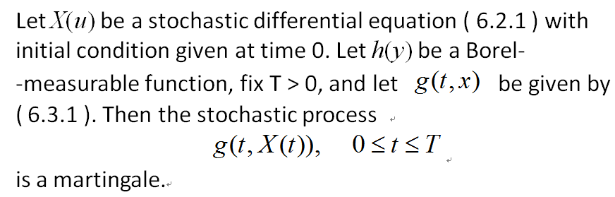
Lemma 6.4.2

Slide 5
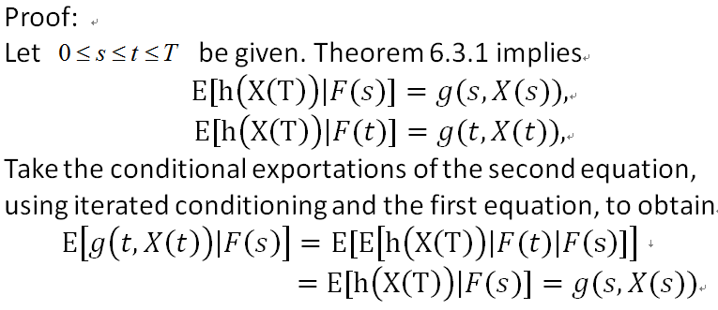

Slide 6
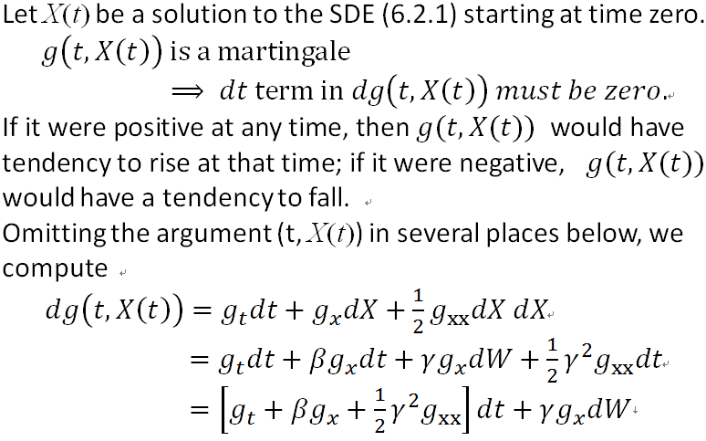
OUTLINE OF PROOF OF THEOREM:

Slide 7
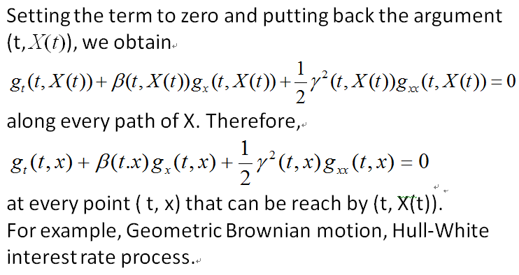

Slide 8
The general principle behind the proof of the Feynman-Kac theorem is:
Find the martingale
Take the differential
Set the dt term equal to zero

Slide 9
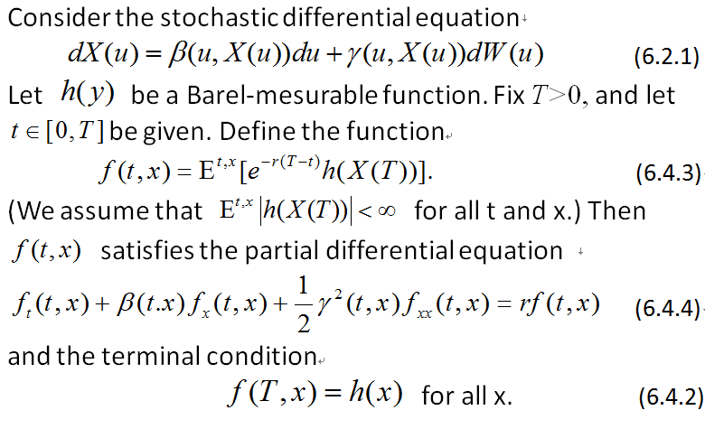
Theorem 6.4.3
(Discounted Feynman-Kac)

Slide 10
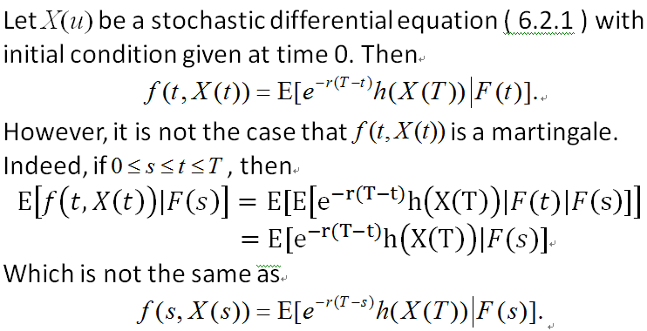
OUTLINE OF PROOF

Slide 11
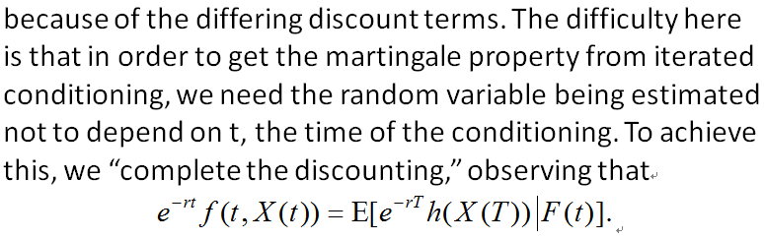
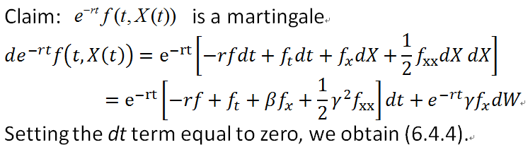

Slide 12
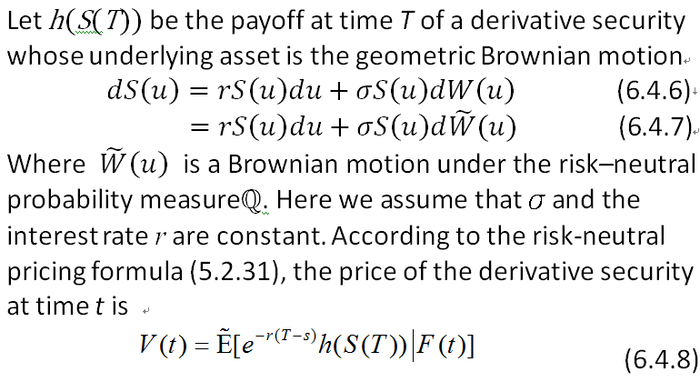
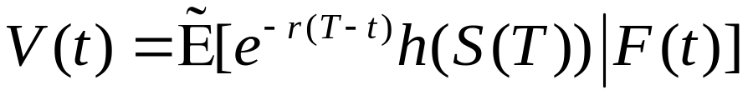
Example 6.4.4
(option on a geometric Brownian motion)
α

Slide 13
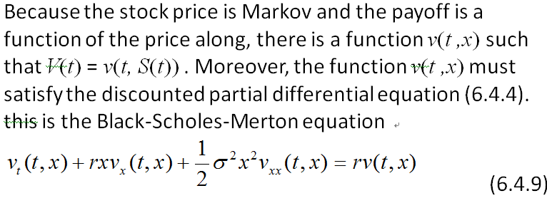

Slide 14
When the underlying asset is a geometric Brownian motion, this is the right pricing equation for a European Call, a European Put, a forward contract, and any other option that pays off some function of S(T) at time T.
The SDE for the underlying asset is (6.4.7) rather than (6.4.6). Because the conditional expectation in (6.4.8) under the risk-neutral measure and hence must use the differential equation .

Slide 15
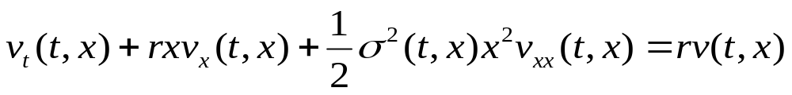
The stock price would no longer be a geometric Brownian motion and the Black-Scholes-Merton formula would no longer apply.
It has been observed in markets that if one assumes a constant volatility, the parameter σ that makes the theoretical option price given by (6.4.9) agree with the market price, the so called implied volatility , is different options having different strikes.
convex function
volatility smile

Slide 16
One simple model with non-constant volatility is the constant elasticity of variance (CEV) model, in which
depends on x but not t. the parameter
is chosen so that the model gives a good fit to option prices across different strikes at a single expiration date.
The volatility is a decreasing function of the stock price.

Slide 17
When one wishes to account for different volatilities implied by options expiring at different dates as well as different strikes, one needs to allow σ to depend on t as well as x . This function σ(t ,x) is called the volatility surface.

